Slide 1

STEM Job Market Situation
Long Bui

Slide 2
Table of Contents
Background
01
Geographical Distributions
02
Takeaways
03
Techstacks Implmented
04

Slide 3

BACKGROUND
Why STEM ?
2) What questions should we focus in ?

Slide 4
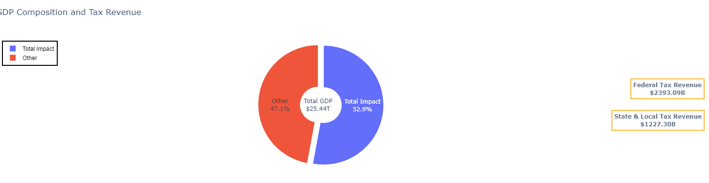
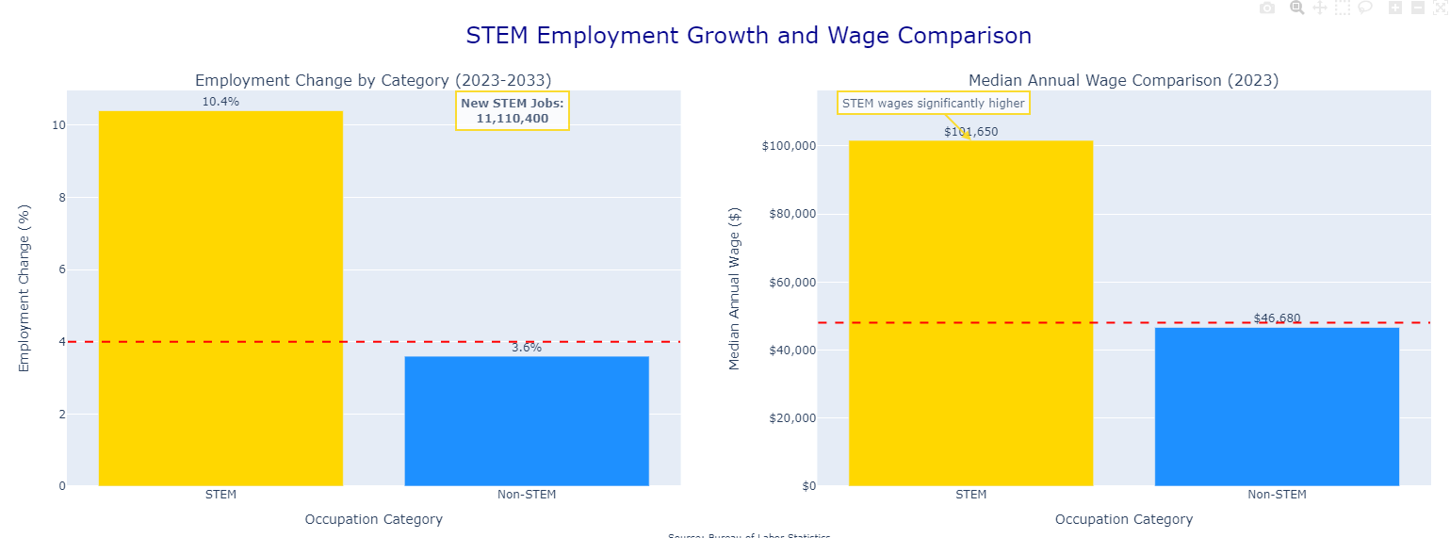
Why STEM ?
+ 11.110.400 jobs created next decade
+ 52% higher earning than average
+ Accounting for 60% of U.S. GDP

Slide 5
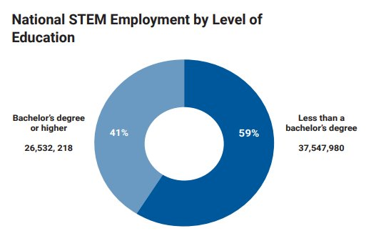
2. What is Happening?
+ 6 out of 10 people in STEM workforces does not have a bachelor's degree or higher
Addressing 2 concerns: + As a student, where should (not) to start your career when that person graduates in STEM majors ?
+ As government officials, how can we understand the overall STEM labor market trends in the US in recent years ?

Slide 6

GEOGRAPHICAL DISTRIBUTIONS

Slide 7
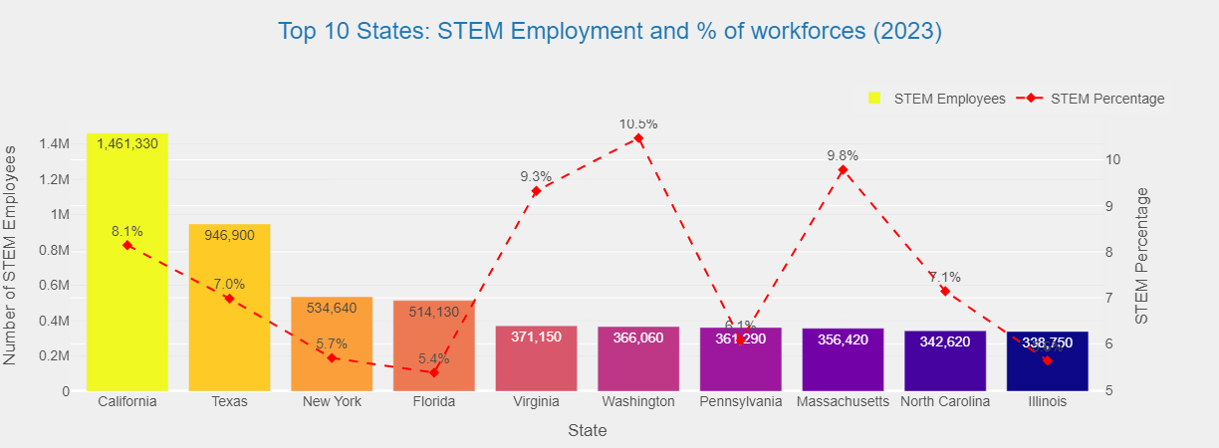
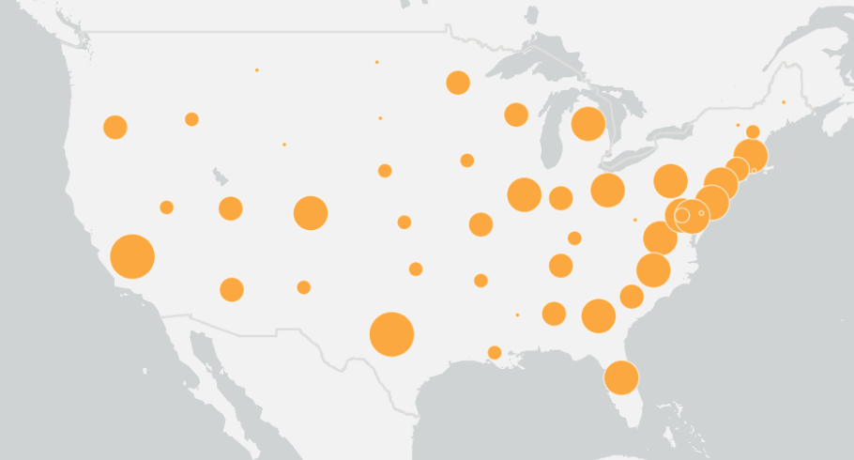
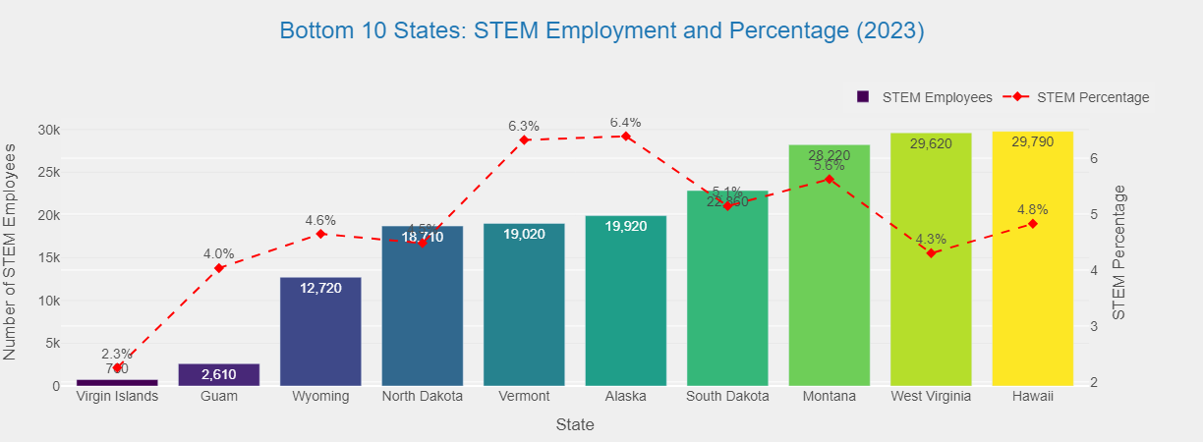
Which states should you start out ?

Slide 8
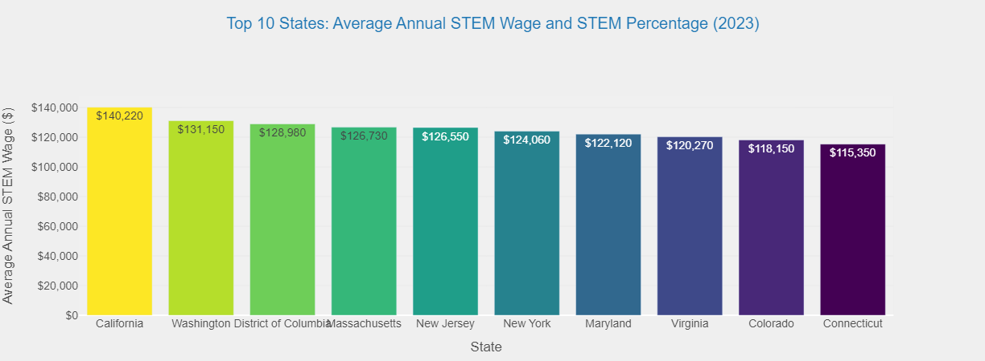
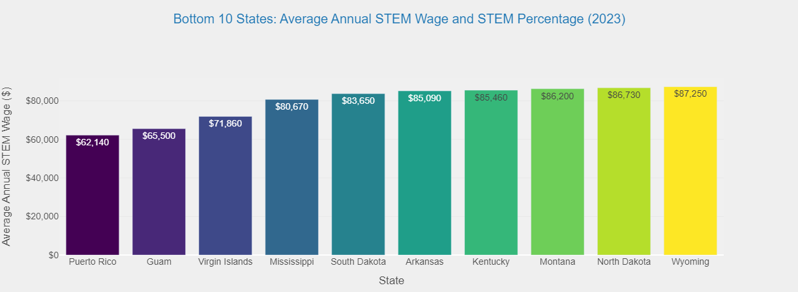
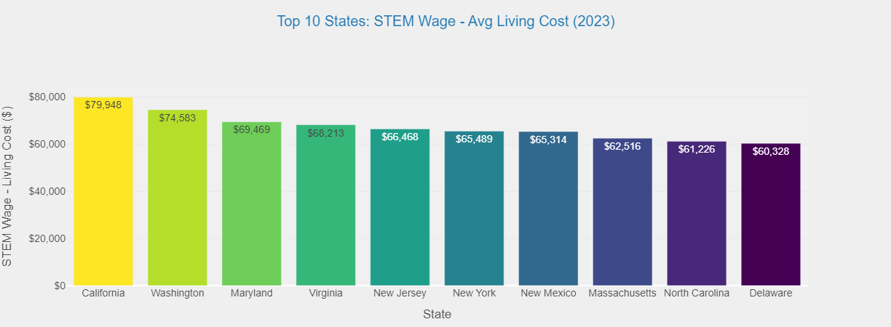
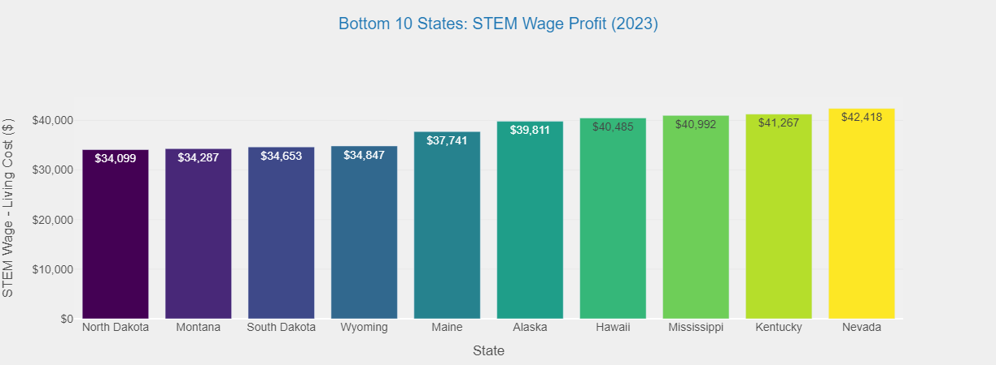
Wage & Living Standard

Slide 9
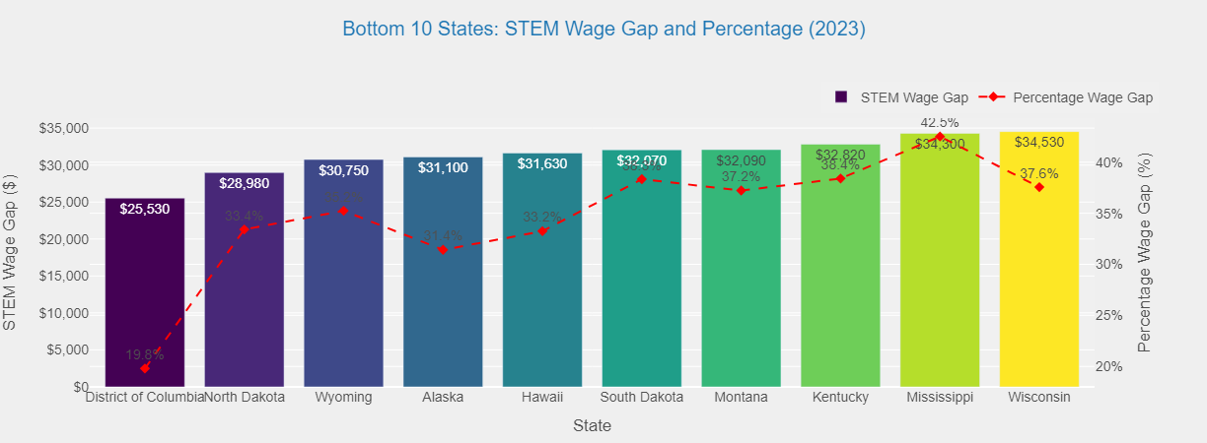
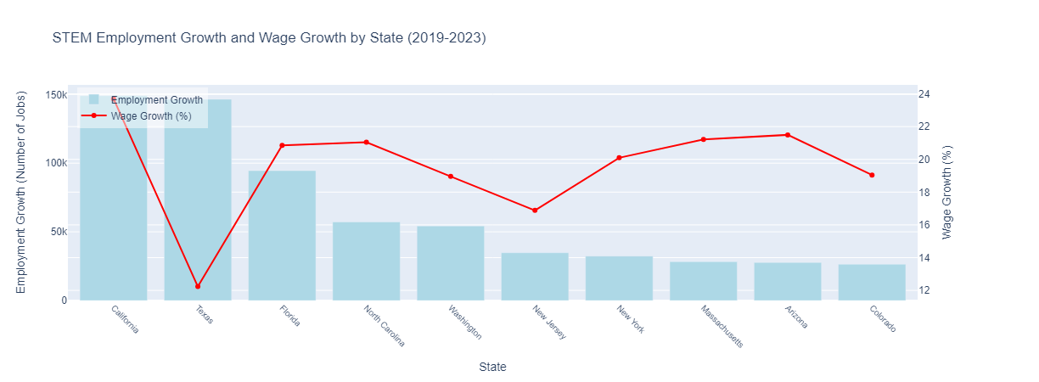
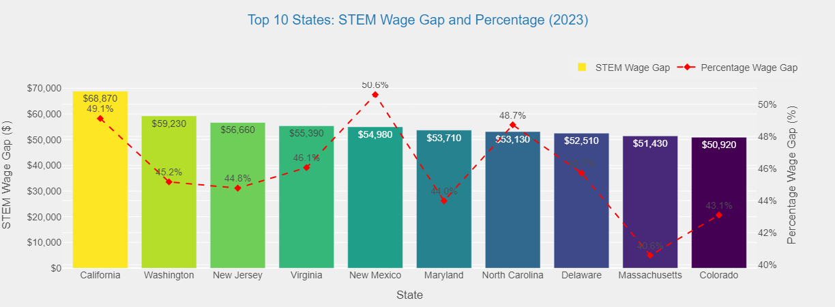
Is that the real value of STEM education? (stem avg wage – non avg)

Slide 10
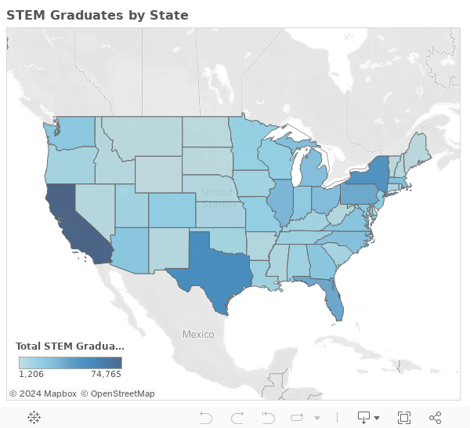
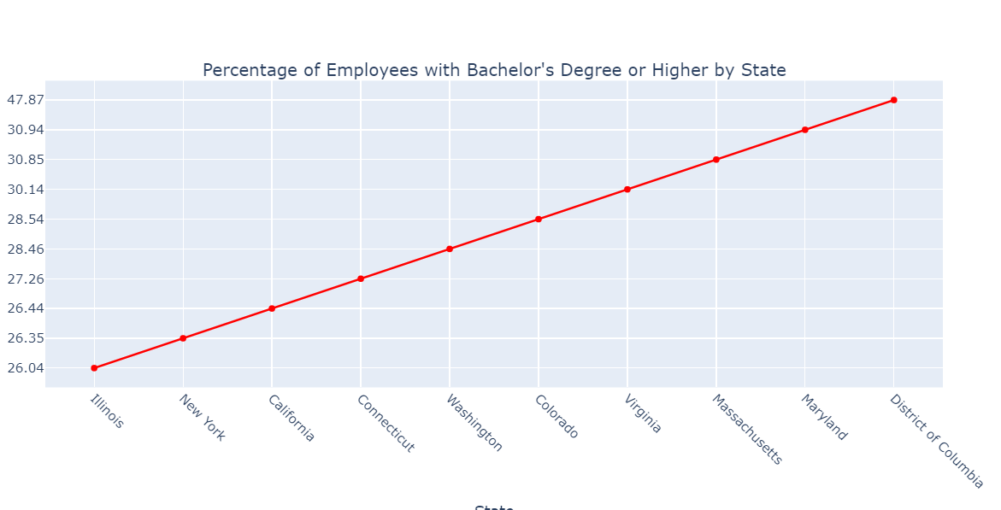
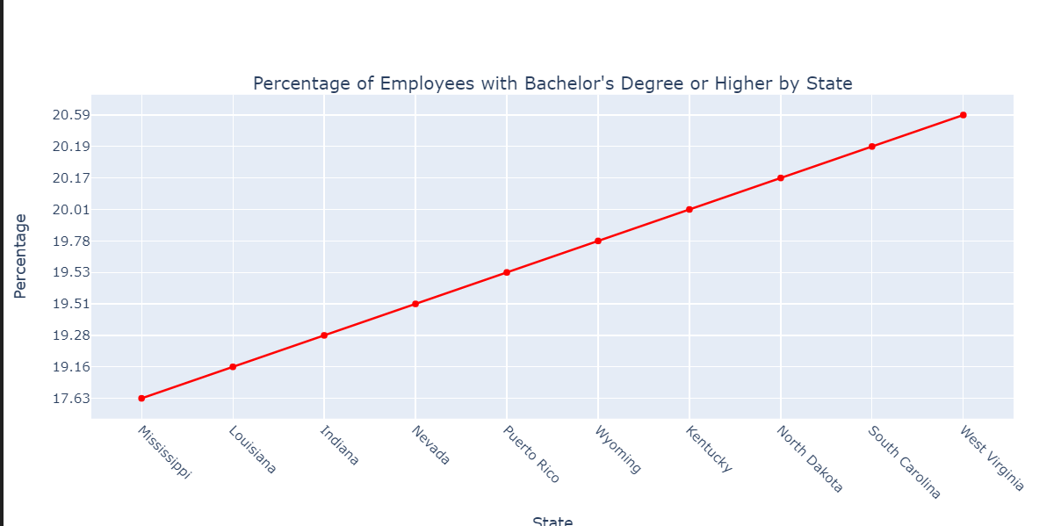
STEM Education Level

Slide 11
III. Takeaways
U.S. STEM job markets are increasing rapidly
Low barriers to enter STEM markets
High disparities between STEM and nonSTEM jobs
High chance of salary increase in the near future in STEMs

Slide 12
Future Directions
Research on county levels
Case study in a state: District of Columbia, California, Washington
Machine learning model to rank best places to start new-grad jobs for STEMs
Dive in specific STEMs fields such as Software Engineer, Data Engineer, Bio Chemistry
Gathering data on patents, Phds enrollment

Slide 13

Behind The Scene

Slide 14
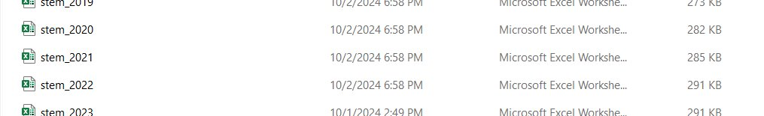
Data Sources
Bureau Labor of Statistics
Census Bureau

Slide 15
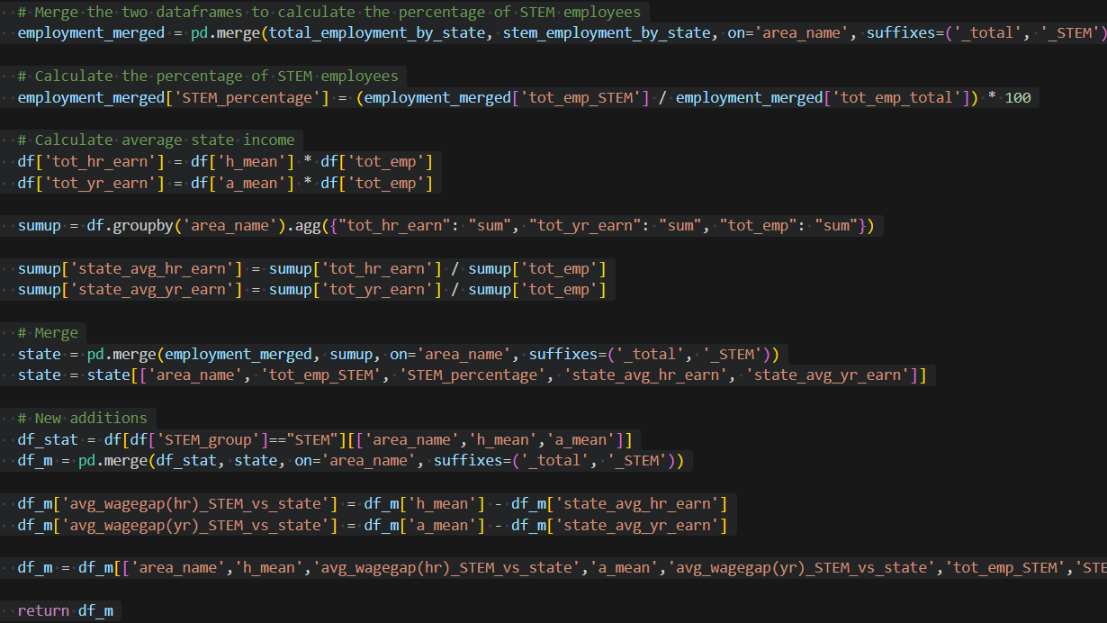
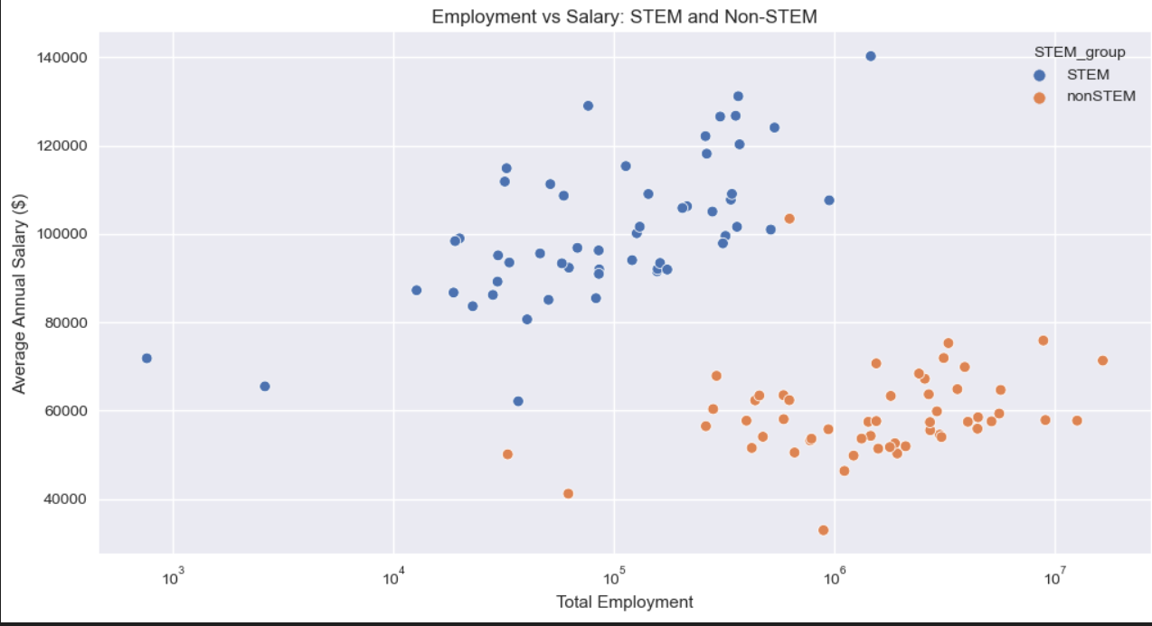
Data Gathering & Preporcessing
+ Implemented Pandas to modfiy/extract data from different files, compose into a single file, and design key metrics for analysis
+ Utilized matplotlib to draw basic visualizations for data exploration and data quality check

Slide 16
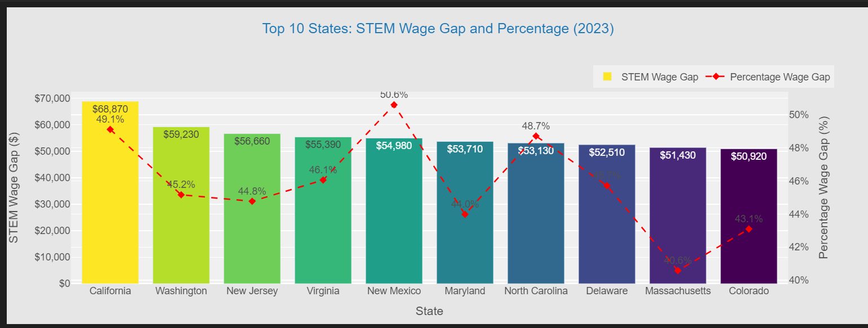
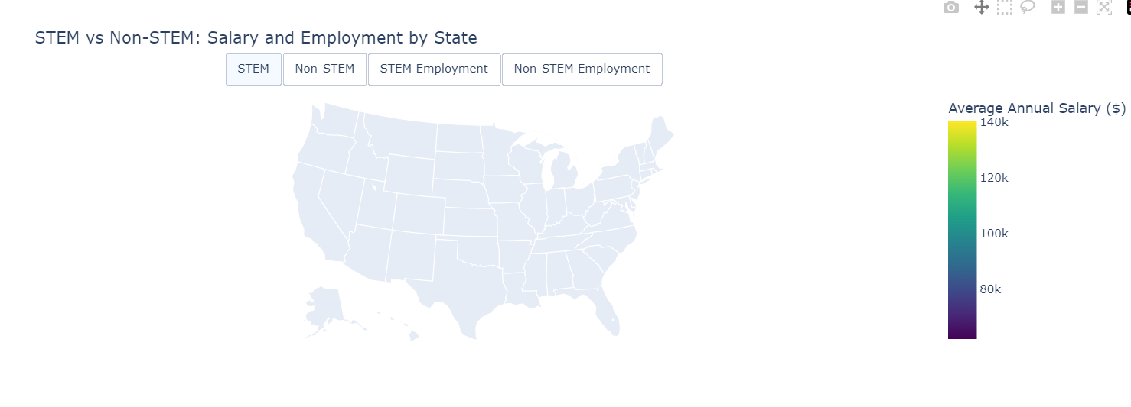
Data Visualization
Optimize Plotly and PowerBI to draw interactive charts where I could interact and compare stats of each states to each others + look more lively

Slide 17

THANK YOU FOR LISTENNING!

